Slide 1
Angular Component Communication
Communicating with a Template
Lecture 1
By James(Jin) Wang
12/27/2021

Slide 2
Outline
Binding and Structural Directives
Two-way Binding, the long way
Getters and Setters

Slide 3
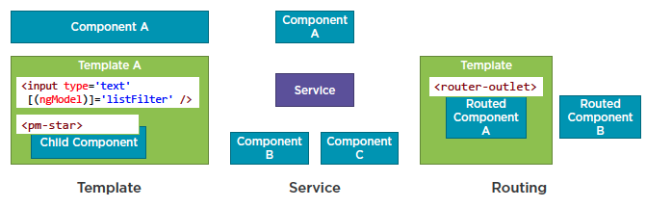
Binding and Structural Directives
  Component Communication

Slide 4
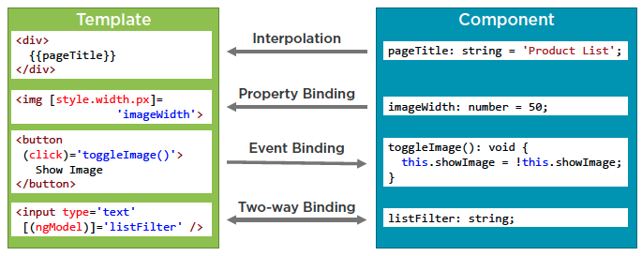
Binding and Structural Directives
  Binding

Slide 5
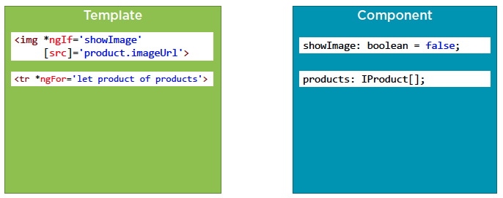
Binding and Structural Directives
  Structural Directives
  product-list.component.ts
  Demo: binding and structural directives

Slide 6
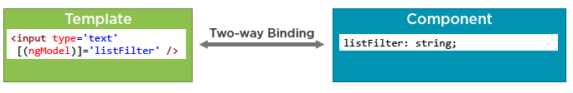
Binding and Structural Directives
  Two-way Binding

Slide 7
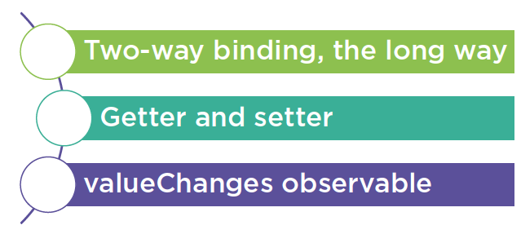
Binding and Structural Directives
  Notify Component of user changes

Slide 8
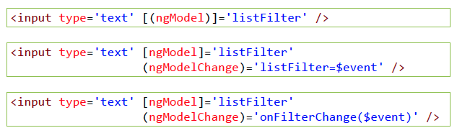
Binding and Structural Directives
  Two-way Binding, the long way
  Demo: two way binding

Slide 9
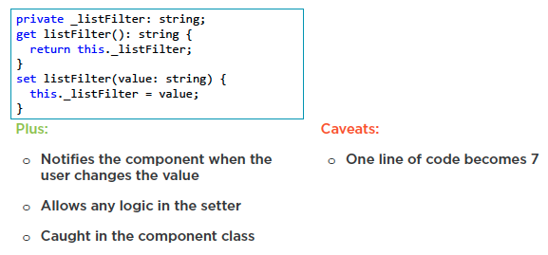
Binding and Structural Directives
  Getter and Setter
  Demo: getter and setter

Slide 10
Summary

Slide 11
Assignment

Slide 12
Self Study
  Angular Component Communication
  https://app.pluralsight.com/library/courses/angular-component-communication

